Slide 1

AFRICAN MOBILE NETWORK SALES ANALYSIS
Frank Krisbianto Gani
I Putu Dedi Setyadi
Vivin Daskar Filiana Waruwu

Slide 2
Background
African Mobile merupakan perusahaan seluler yang berdiri pada tahun 2010. Pada awal mula berdirinya, perusahaan ini hanya menjual produknya ke beberapa wilayah di regional selatan. Seiring berjalannya waktu, perusahaan mulai berkembang ke beberapa negara yang berada di regional barat. Hingga saat ini perusahaan sudah menjual produknya ke berbagai negara di Benua Afrika.
Pada tahun 2013 African Mobile mulai melakukan ekspansi secara masif. Perusahaan ini menjual produknya ke beberapa negara bagian di Afrika, baik di regional utara, timur, selatan, barat, mapun bagian tengah. Perusahaan ini juga melakukan penjualan ke berbagai segment, diantaranya commercial, public, dan residential.

Slide 3
Question
What segment netted the highest profit?
Where is the city that have the least profit and need the sales to be boosted?
When AMN reached the highest sales ?
How do we increase the sales ?
Who are the top 3 salesperson that have the highest close rate in the africa?
Who have the most proposed contract in africa?

Slide 4
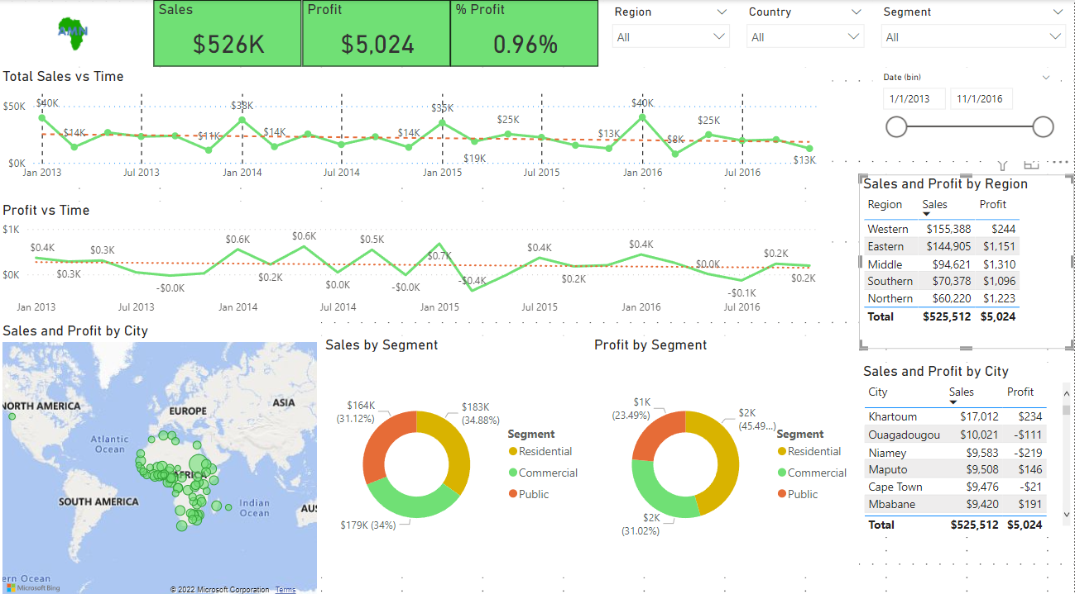
Dashboard

Slide 5
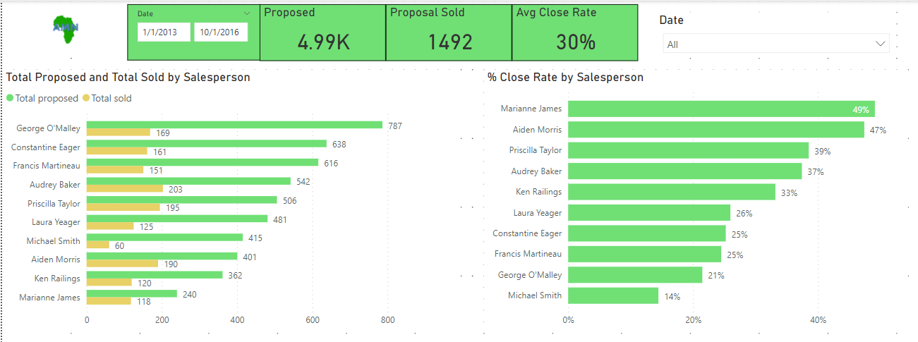

Slide 6
Conclusion
What segment netted the highest profit? Residential
Where is the city that have the least profit and need the sales to be boosted? Niamey, Lagos, Yamoussoukro
When AMN reached the highest sales ? Q4 of the year
How do we increase the sales ? Reduce the cost and market a lot more in the middle of the year

Slide 7
Conclusion
Who are the top 3 salesperson that have the highest close rate in the africa? Marriane James,Aiden Morris and Priscilla Taylor
Who have the most proposed contract in africa? George OMalley

Slide 8
Recommendation
Boost the sales on Q1-Q3 by implementing various marketing programs
Focus on the northern Africa because it netted the most profit
Have Michael Smith learn more about proposal and encourage Marriane James to be more active

Slide 9

Thank you

